Slide 1
Research for week 6
Xiaoshu Luo

Slide 2

Continuing on GPR
Randomforest and boosted trees are a bit higher

Slide 3
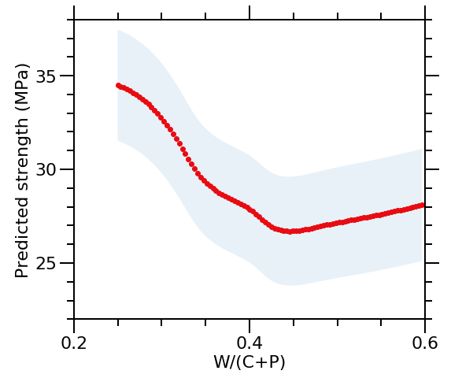
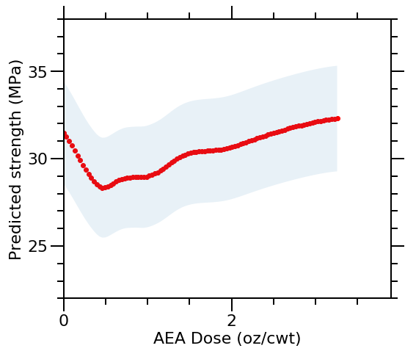
Trying to predict using one single variable while keeping others constant (mean)

Slide 4
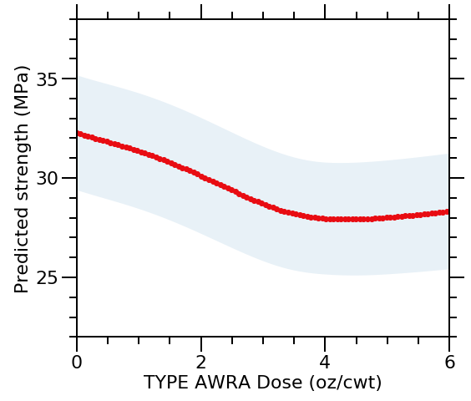
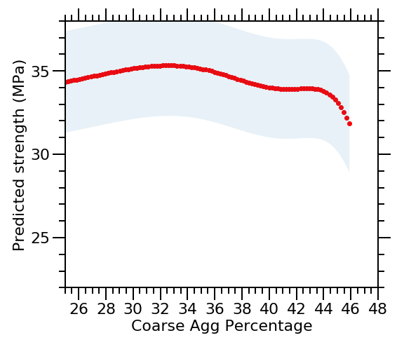

Slide 5
